Slide 1
Introduction to Machine Learning

Slide 2
Domains
• Probability and Statistics
• Optimization
• Linear Algebra
• Computer Science

Slide 3
Vocabulary
• Observations
• Features
• Labels
• Training and Test Data

Slide 4
Common tasks
Supervised learning (WITH LABELS)
Classification
Regression
Unsupervised learning
(WITHOUT LABELS)
Clustering
Dimensionality reduction

Slide 5
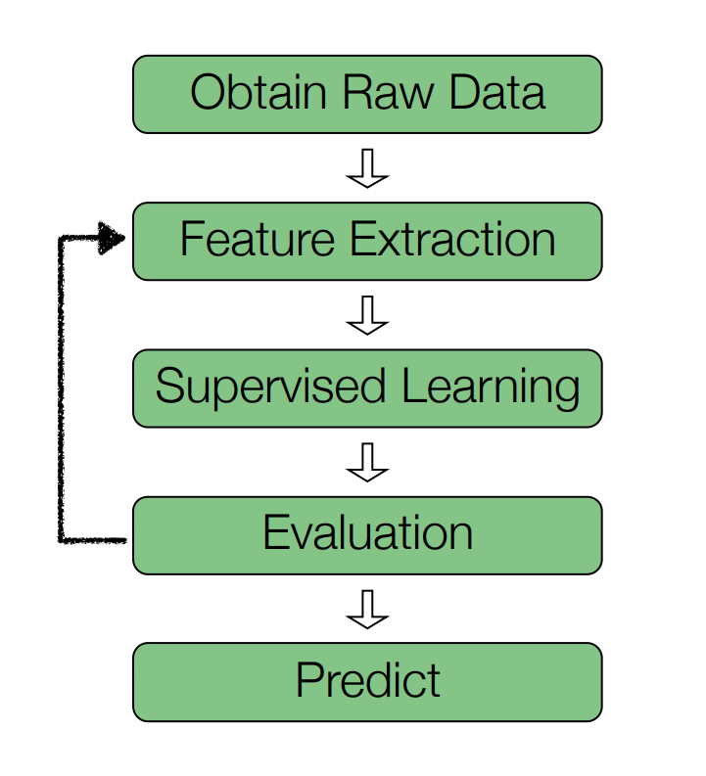
Supervised Learning Pipeline

Slide 6
Classification Pipeline
bot - human
click - not click
spam - ham

Slide 7
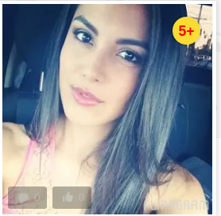

Labels
Bot
Human

Slide 8
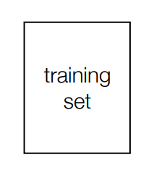
Raw data

Slide 9
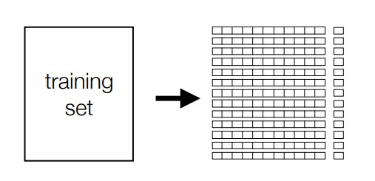
Feature extraction

Slide 10
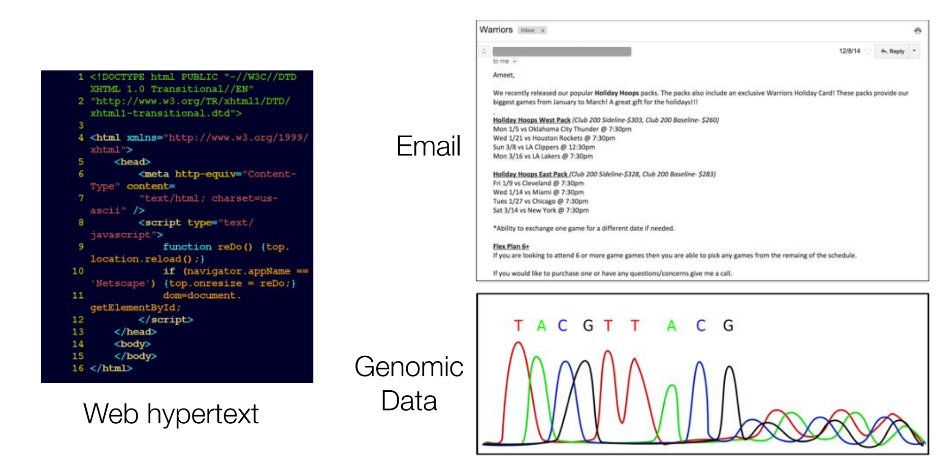

Slide 11
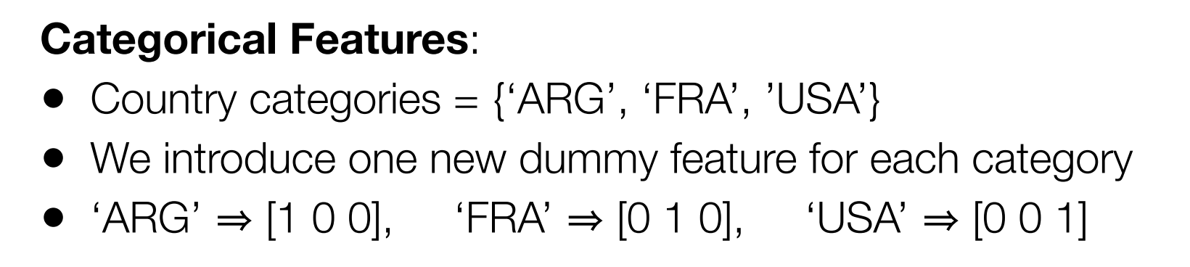
One hot encoding

Slide 12
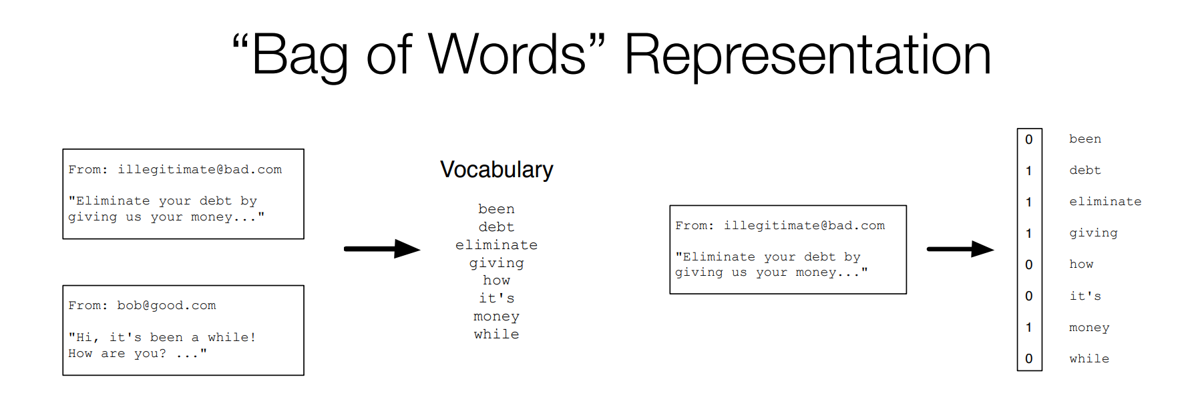

Slide 13
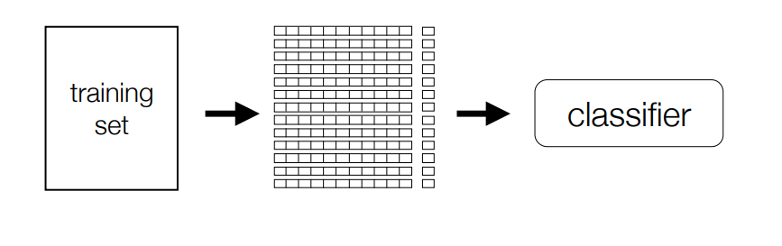
Train model

Slide 14
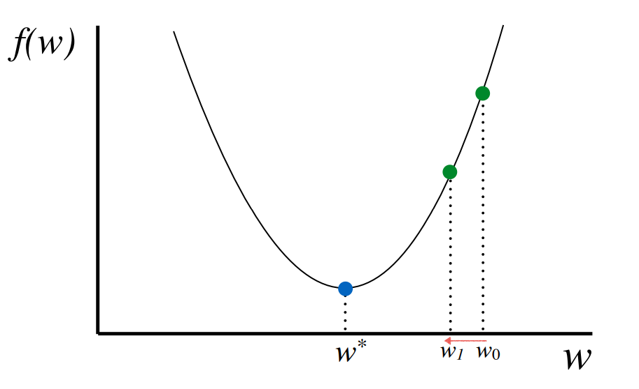
Gradient descent

Slide 15
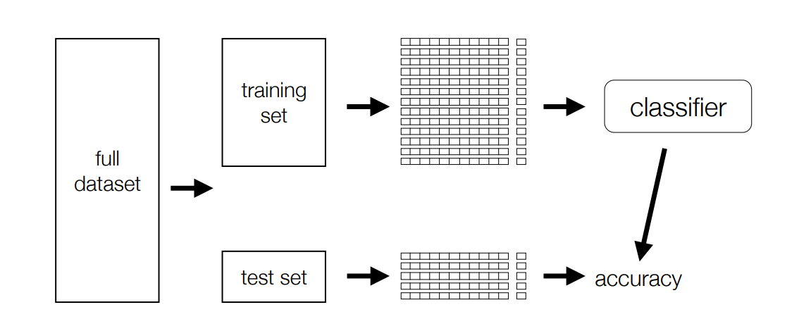
Verified model

Slide 16
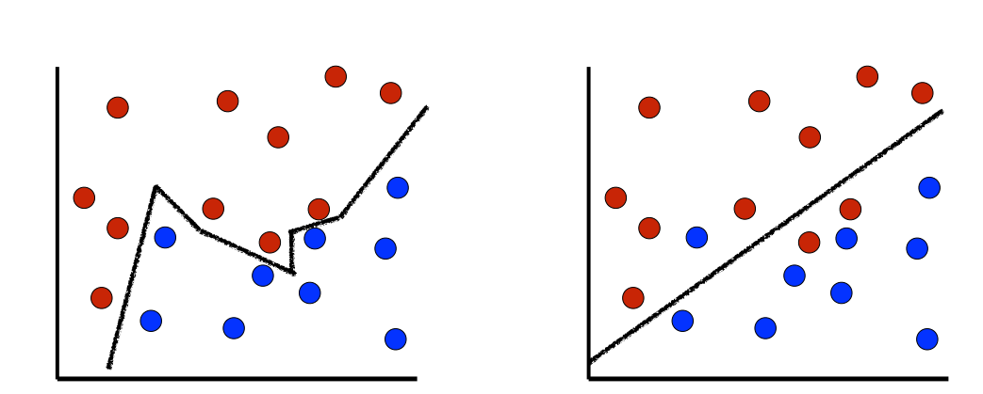
Overfitting

Slide 17
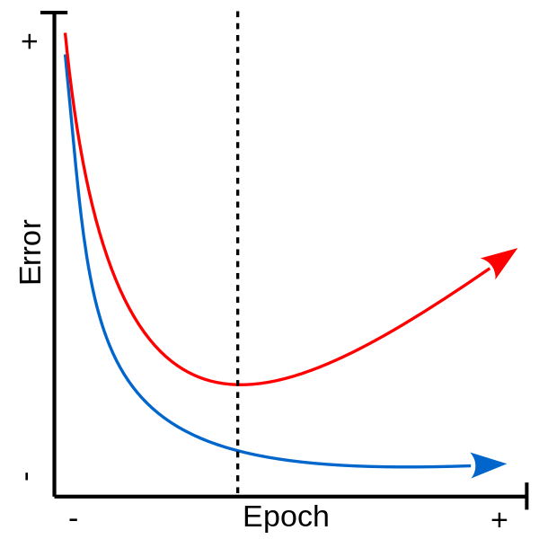
Error

Slide 18
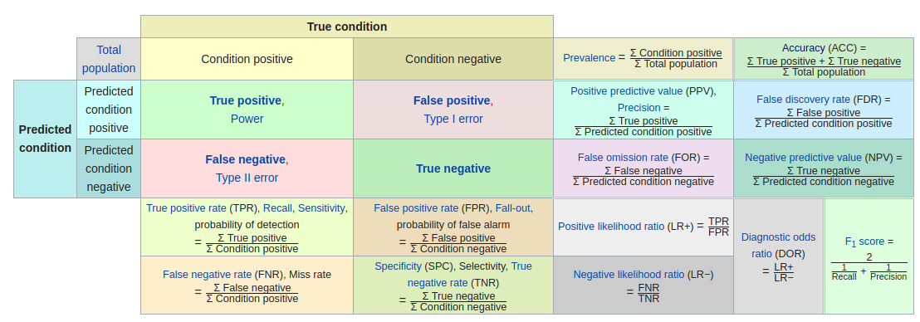
Classification metrics

Slide 19
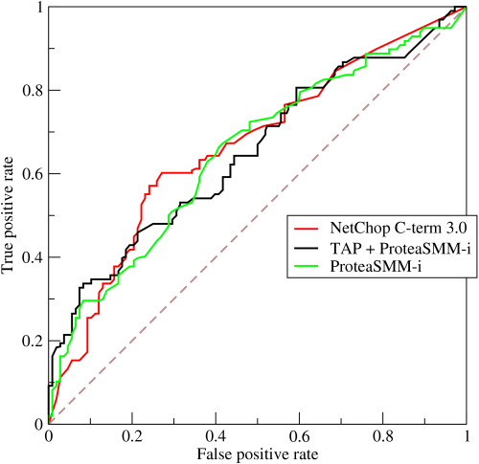
AUC

Slide 20
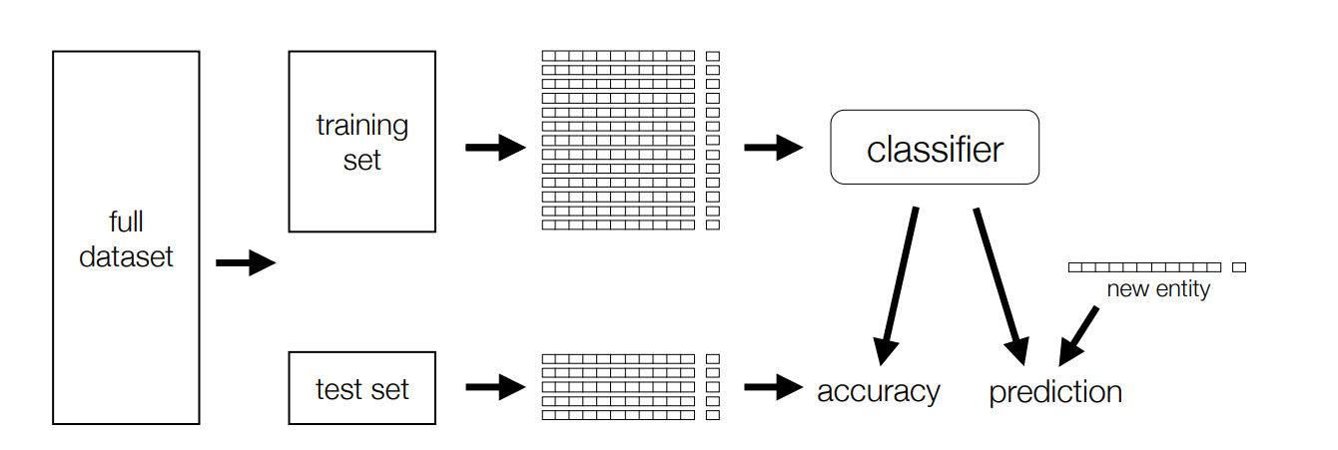
Full cycle

Slide 21
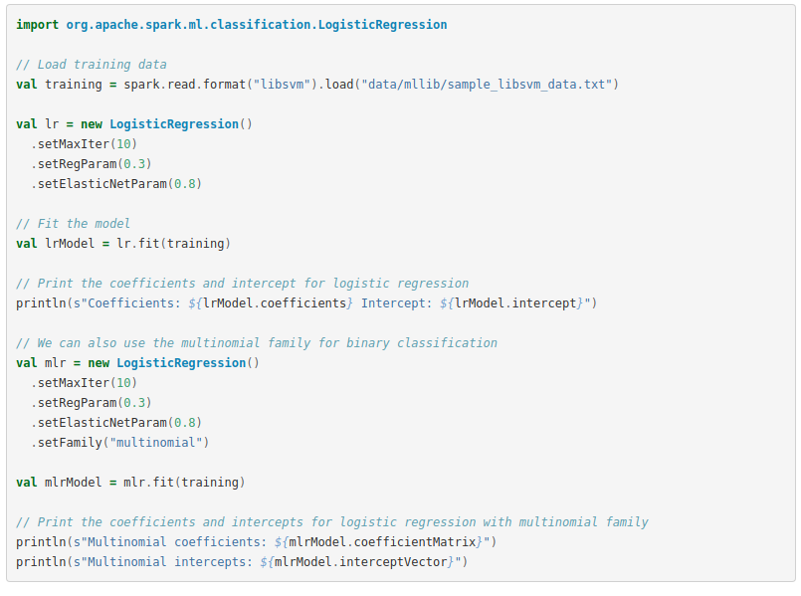
Spark Example

Slide 22
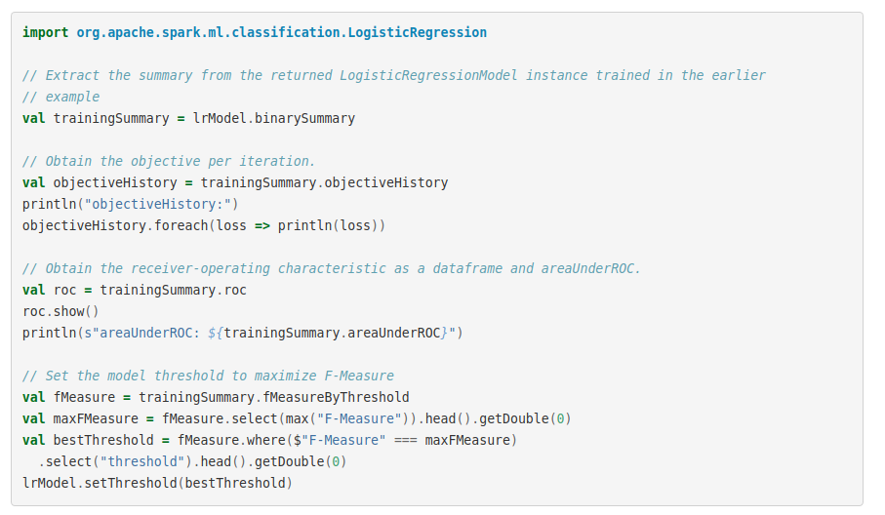
Spark Example

Slide 23
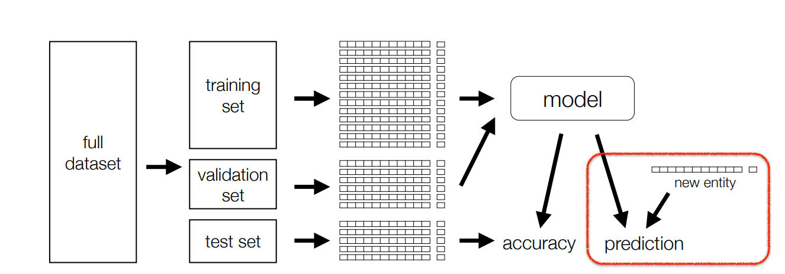
Full Full cycle

Slide 24
Thanks!

